Slide 1
Using matlab to Isolating a desired object in an image and finding it's diameter

Slide 2
Motivations
Measuring objects within an image or frame can be an important capability for many applications where computer vision is requited instead of making physical measurements. Here are some key motivations:
Quality Control: In manufacturing or production processes, ensuring the dimensional accuracy of components is essential for maintaining product quality.
Forensic Investigations: In forensic science, analysing image to measure the diameter of objects like tool marks or abrasions can provide valuable evidence for criminal investigations.
Diagnostics and Monitoring: In fields like medicine and biology, measuring the diameter of structures such as tumors, cells or organs can be crucial for diagonosis.

Slide 3
Process

Slide 4
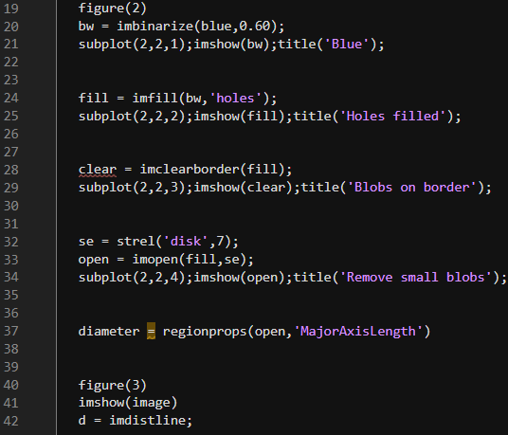
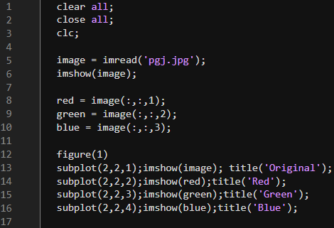
Complete code
sa
Looking at the entire code at once can be a bit challenging so let us go through the code and try to understand the algorithm one step at a time.

Slide 5
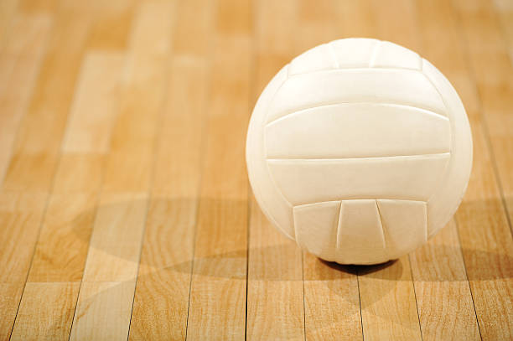

Let us take the image of a volleyball for example
1st we must import the image in MATLAB

Slide 6
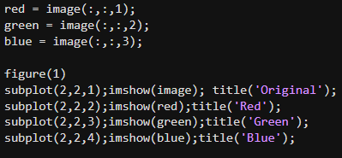
We need to modify this image to differentiate the background from the desired objects.
For this we 1st divide the image into three images based on the intensities of red, green and blue components within the image.

Slide 7
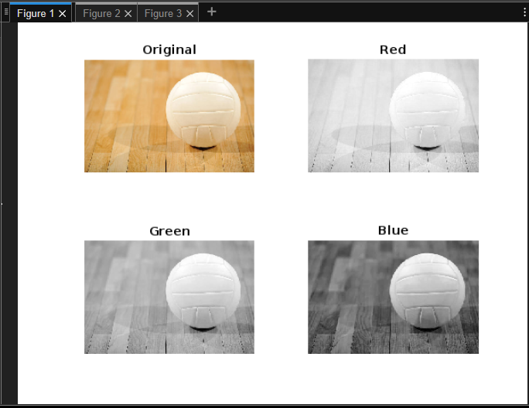
We can clearly see that the blue plane has the most contrast between the object and background so we shall convert it into the binary image of the desired intensity.

Slide 8

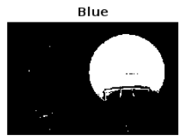
We turn the blue plane into a binary image where pixels with intensity less than 0.6 are converted to 0(black) and the rest are converted to 1(white).
As we can se there is a bit of noise in in the resulting binary image so next we will attempt to remove this noise.

Slide 9

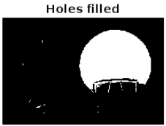
This function fills holes in the input binary image
The holes were filled.

Slide 10

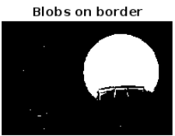
This function removes any continuous segment of white pixels connected to the border of the image
Unfortunately there were no white segments touching the image border in this example.

Slide 11

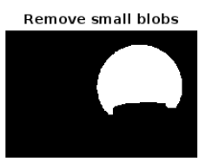
This removes small white blobs of radius less than 5 pixels.
As we can see that after all these steps we have successfully isolated the desired object from the background.

Slide 12
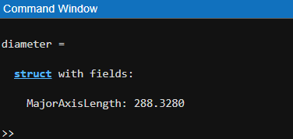
This function measures the longest diameter in pixels and since we did not end the line with a ‘;’ we will get measurement as output int the command window.
We can se that the diameter of the ball comes out to 288.3 pixels according to the algorithm.

Slide 13

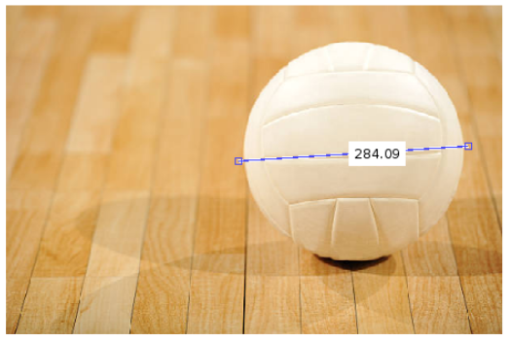
We can compare the answer ourselves using the distance tool created by ‘imdistline’ function on the original image.
As we can se the answer we got from the algorithm is close to the actual diameter of the volleyball.

Slide 14
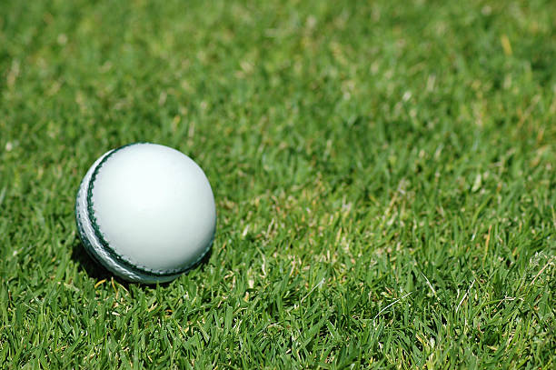
Some other examples
Since it is IPL season let us take the example of a cricket ball.

Slide 15
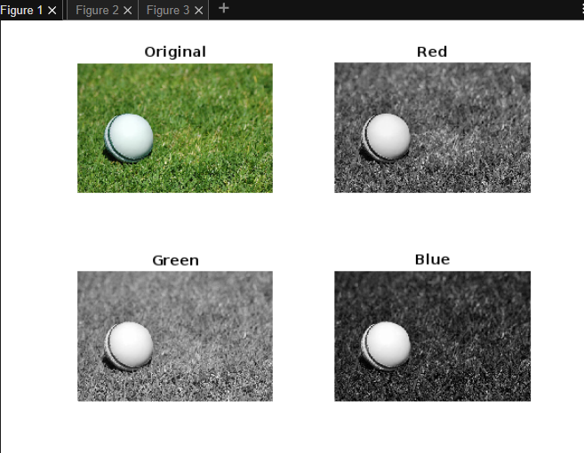
Again blue plane has the best contrast between object and fore ground.

Slide 16

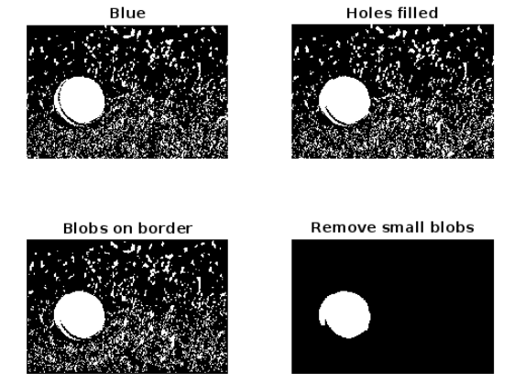
It is important to carefully select the intensity values to be able to accurately measure the object.
We can see how well the noise suppression works in this example

Slide 17
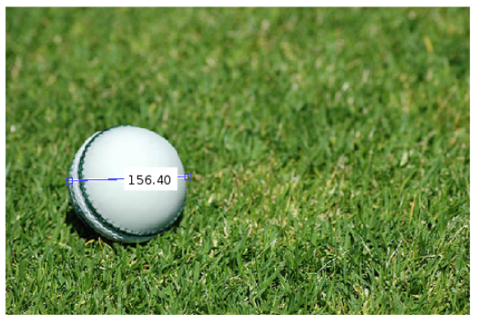
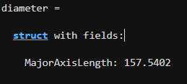
We were able to get an almost exact measurement of the ball.

Slide 18
Applications
Isolating a desired object in an image and finding it’s diameter has numerous applications across various field:
Medical Imaging: In medical imaging, such as X-rays or MRI scans, identifying and measuring the diameter of tumours or other anomalies can aid in diagnosis and treatment.
Astronomy: Astronomers often need to measure the apparent size of celestial objects. Isolating these objects in astronomical images and measuring their diameters can provide valuable data.
Robotics and automation: In automation , identifying and measuring objects’ diameters in images can be essential for tasks like object manipulation, sorting, or assembly.

Slide 19
Thankyou

